Slide 1
2

Slide 2
Project Description
The cost of living is a critical metric affecting both individuals and businesses.
Understanding the cost of living across various cities and countries is essential for making informed decisions about relocation, investment, or business expansion.
This project aims to address several key questions:
Which cities and countries have the highest and lowest costs of living?
What are the major cost components contributing to the overall cost of living in a region?
How do factors like average salary, housing costs, and transportation expenses correlate with the cost of living?
Are there trends or patterns in the data that can help individuals and organizations make strategic decisions?

Slide 3
Approach
First, I connected to the provided dataset (.csv) using Power BI Desktop and transformed it using Power Query Editor to ensure data quality.
Next, I conducted Exploratory Data Analysis (EDA) to identify trends, outliers, and relationships among variables.
After completing the necessary data transformations, I returned to Power BI Desktop to proceed further
Then, I utilized the Table, Report, and Model views to add new columns, create measures, set key columns, and create hierarchies.
Finally, I visualized the cost of living data using Power BI's interactive features to derive meaningful conclusions.

Slide 4
Dataset Description :
■ The dataset utilized in this project is sourced from Numbeo, a collaborative online
database that provides cost of living information worldwide.
■ It contains 56 columns, including information about cities, countries, and a wide array
of cost-related variables, ranging from grocery prices to real estate costs.
■ The dataset consists of the following variables:
• City: Name of the city.
• Country: Name of the country.
• x1 – x55: cost-related variables.
• data_quality: A binary variable (0 or 1) indicating data quality

Slide 5
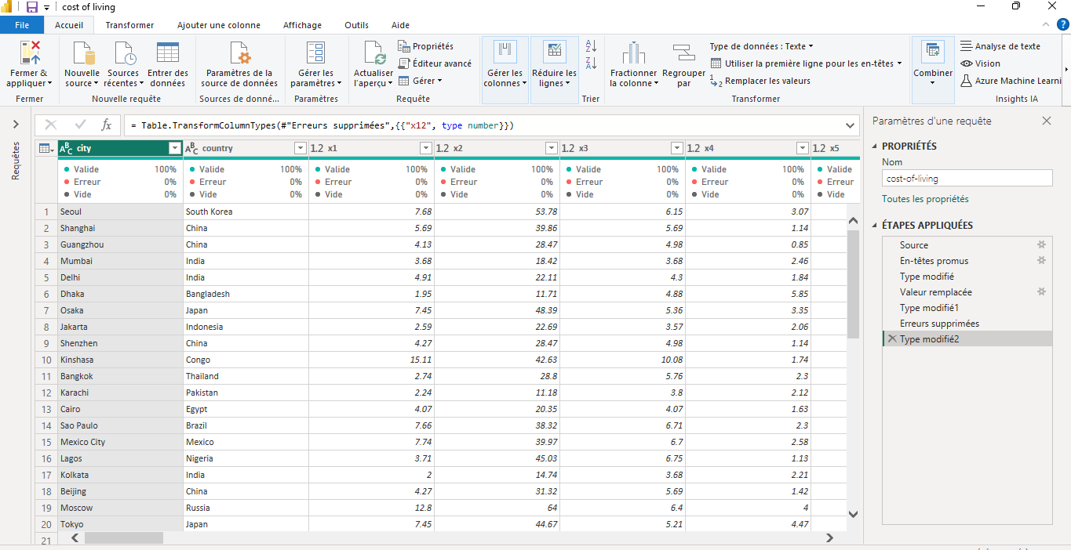
Overview of the Dataset

Slide 6
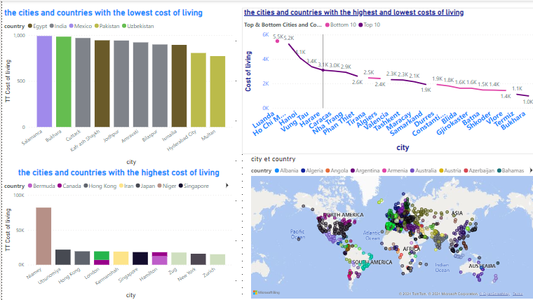
• What are the cities and countries with the highest and lowest costs of living?

Slide 7
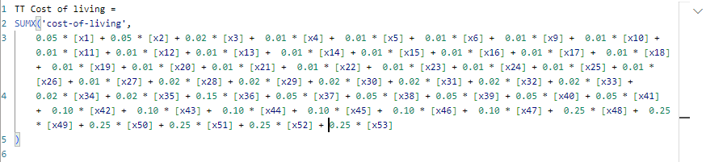
In the measurement script, coefficients are applied to the different cost variables (x1, x2, ..., x53) to calculate a weighted sum. This method is used to reflect the relative importance of each component in the calculation of the total cost of living.
To select the first 10 values and the lower values, I create these next 2 measures

Slide 8
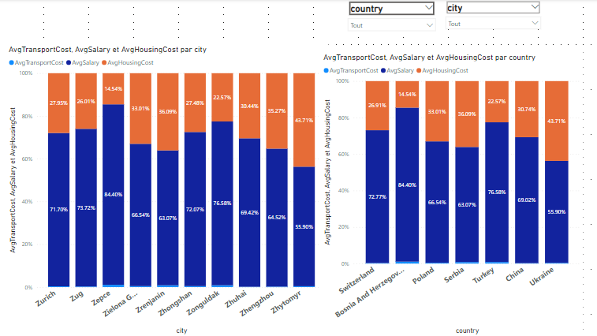
• What are the major cost components contributing to the overall cost of living in a region?

Slide 9

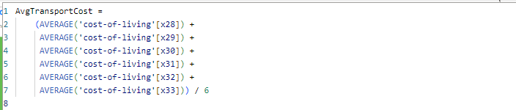
Representation of Housing Costs:
x48: Cost of a one-bedroom apartment in the city center.
x49: Cost of a one-bedroom apartment outside the city center.
x50: Cost of a three-bedroom apartment in the city center.
x51: Cost of a three-bedroom apartment outside the city center.
In the AvgHousingCost measure, the variables
x48,x49,x50,x51 represent different housing costs. Here’s why these specific variables are arranged in this way in the measure:
These four variables cover the primary types of housing that an individual or family might look for, both in the city center and in the suburbs, and for different sizes of apartments.
Averaging the Housing Costs
Calculating the average of these variables provides a general estimate of housing costs in a region, taking into account the possible variations between different types of housing and their locations. This offers a comprehensive measure that can be used for broader comparisons and analyses.
DAX Script for AvgHousingCost →
DAX Script for AvgSalary →
DAX Script for AvgTransportCost

Slide 10
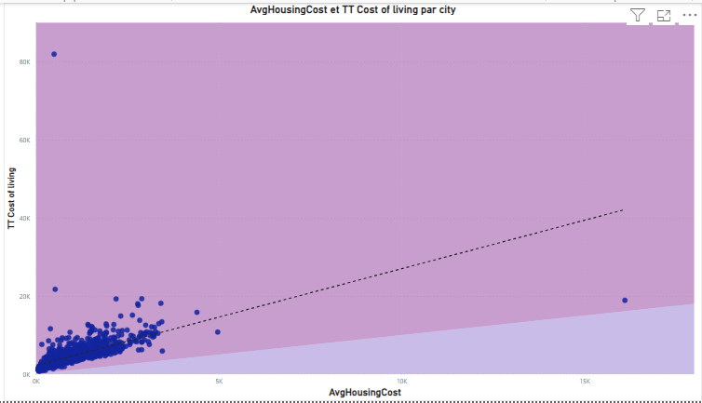
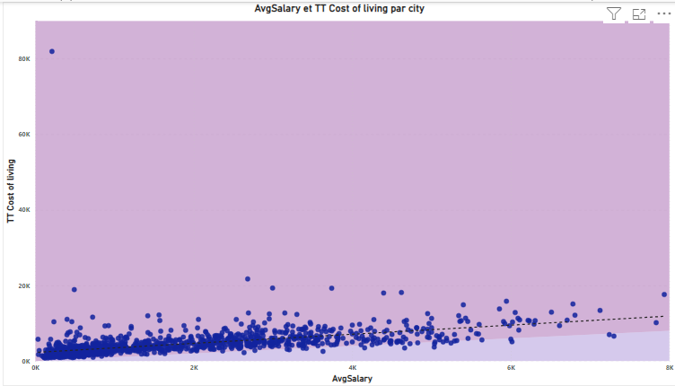
How do factors like average salary, housing costs, and transportation expenses correlate with the cost of living?

Slide 11
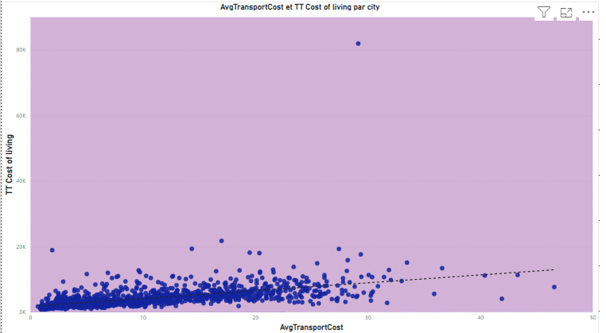

Slide 12
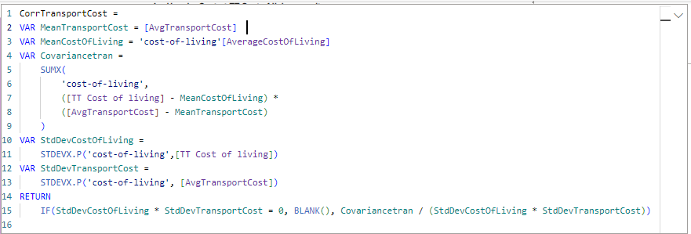
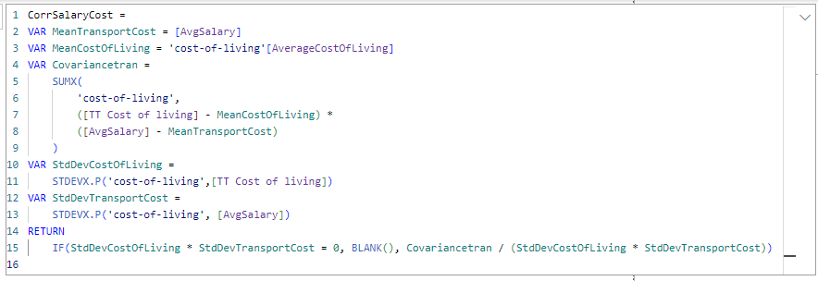
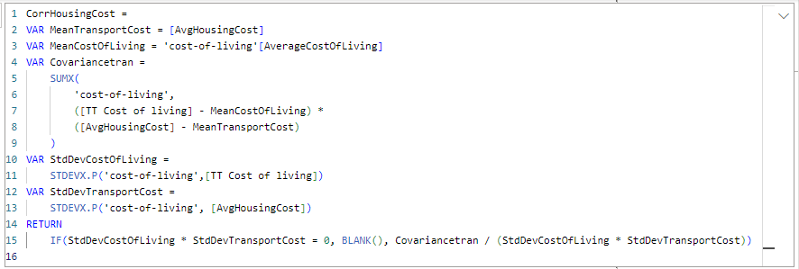
Calculating correlations

Slide 13
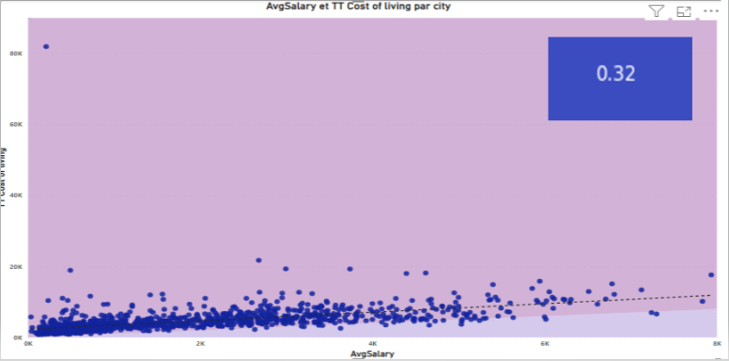
Evaluating the relationship between average salaries and the cost of living can provide insights into the affordability of different regions. Regions with high salaries but proportionately lower living costs can be more attractive.
Strategic Decision: Consider regions where average incomes provide better purchasing power relative to the cost of living. This can enhance the quality of life for employees and optimize operational costs for businesses.

Slide 14
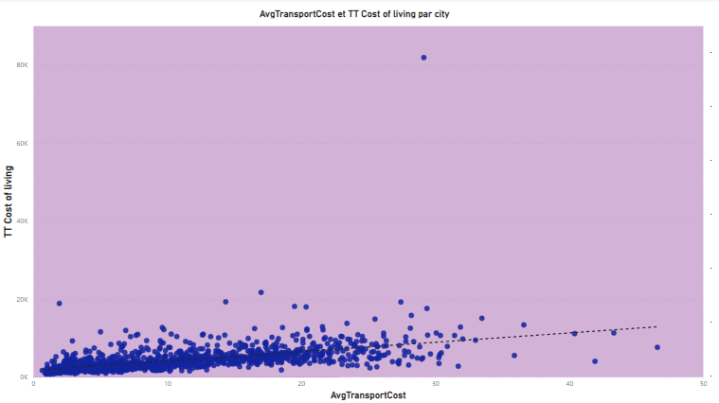

The correlation between average transportation costs (AvgTransportCost) and the overall cost of living (cost_of_living) is 0,22 . This indicates a moderate positive relationship, suggesting that as transportation costs increase, the overall cost of living tends to increase as well.
Strategic Decision: When considering relocation or business expansion, individuals and organizations should account for transportation costs as a significant factor that can affect the overall cost of living in a region.

Slide 15


Slide 16
CONCLUSION
After analyzing all the data, it can be concluded that certain countries are extremely expensive to live in, as even the prices for basic needs are significantly higher compared to other countries. Essential rights such as education, food, clothing, and water are disproportionately costly and should be more aligned with other regions. In areas where the average salary is low but the cost of necessities is high, there should be an increase in wages to better support the population.

